Slide 1
Fraud Transaction Detection With Random Forest Classifier
By Ansh Kapil

Slide 2
Project Overview:
In recent years, there has been a significant rise in fraud attempts, highlighting the importance and challenge of fraud detection. Despite extensive efforts and human oversight, millions of dollars are lost to fraud annually. Fraud can occur through various methods such as stolen credit cards, deceptive accounting practices, phishing emails, and more. Detecting fraud is particularly challenging due to the small number of fraudulent cases in a large population.
Data mining and machine learning play a crucial role in anticipating and swiftly identifying fraud, enabling quick action to minimize costs. With data mining tools, vast numbers of transactions can be analyzed to identify patterns and detect fraudulent transactions.

Slide 3
Reading and exploring the dataset:
We begin by loading the dataset using pandas' `read_csv()` function, which reads the dataset and converts it into a structured tabular format that we can easily analyze.

Slide 4
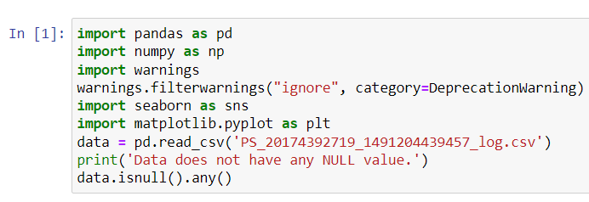
Input Code:

Slide 5
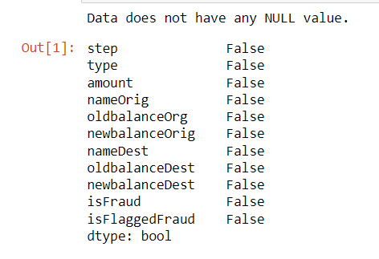
Output:

Slide 6
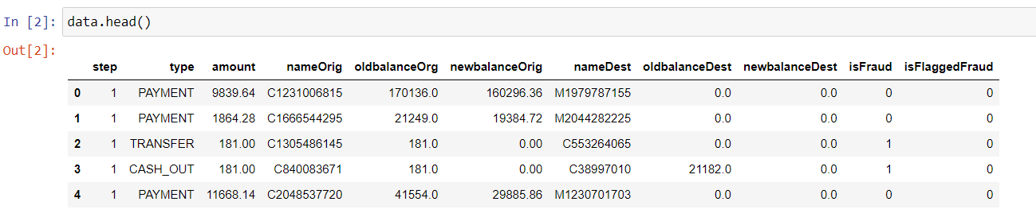
Displaying the Code with the help of head command:

Slide 7
The Problem of Dataset:
The provided data has the financial transaction data as well as the target variable isFraud, which is the actual fraud status of the transaction and isFlaggedFraud is the indicator which the simulation is used to flag the transaction using some threshold value.

Slide 8
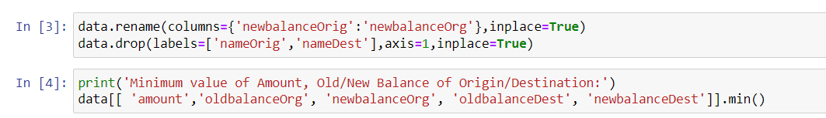
Input Code:

Slide 9
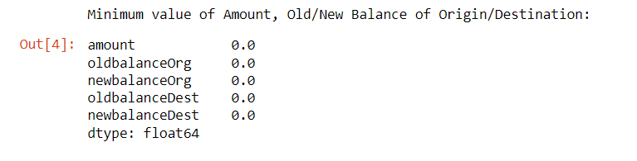
Output:

Slide 10
Data Analysis:
Since there is no missing and garbage value, there is no need for data cleaning, but we still need to perform data analysis as data contaion huge variation of the value in different columns. Normalization will also improve the overall accuracy of the machine learning model.

Slide 11
Input Code:

Slide 12
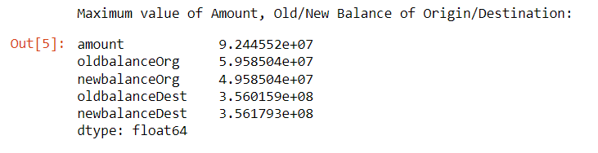
Output:

Slide 13
Plotting the dataset
The code groups the data by 'type', calculates the sum of 'amount' for each group, and then creates a bar chart to visualize the total amount per transaction type. The x-axis represents the different transaction types, and the y-axis represents the total amount. The bars in the chart will have heights corresponding to the total amount for each transaction type.
This code allows you to quickly visualize and compare the total amounts associated with different categories or types within a dataset using a bar chart.

Slide 14
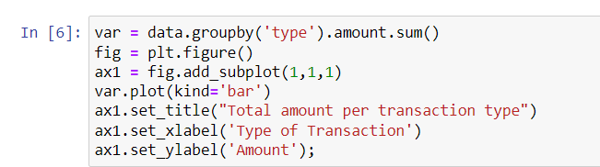
Input Code:

Slide 15
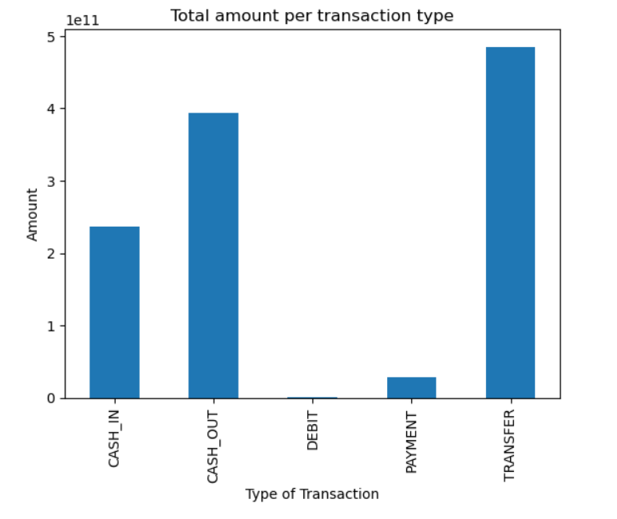
Output:

Slide 16
About the Bar Graph:
The graph indicates that "TRANSFER" and "CASH_OUT" are the most common modes of transaction, and they are also the only methods through which fraud occurs. Therefore, our focus will be on these types of transactions.

Slide 17
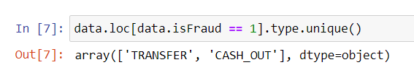
Input Code:

Slide 18
Heat Map of the Data Attributes:
OldbalanceOrg and NewbalanceOrg are highly correlated.
OldbalanceDest and NewbalanceDest are highly correlated.
Amount is correlated with isFraud(Target Variable).
There is not much relation between the features, so we need to understand where the relationship between them depends on the type of transaction and amount. To do so, we need to see the heat map of fraud and nonfraud transactions differently.

Slide 19
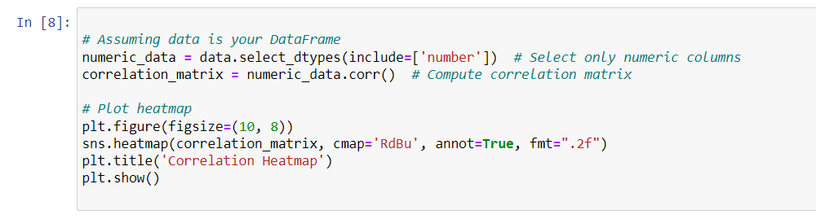
Input Code:

Slide 20
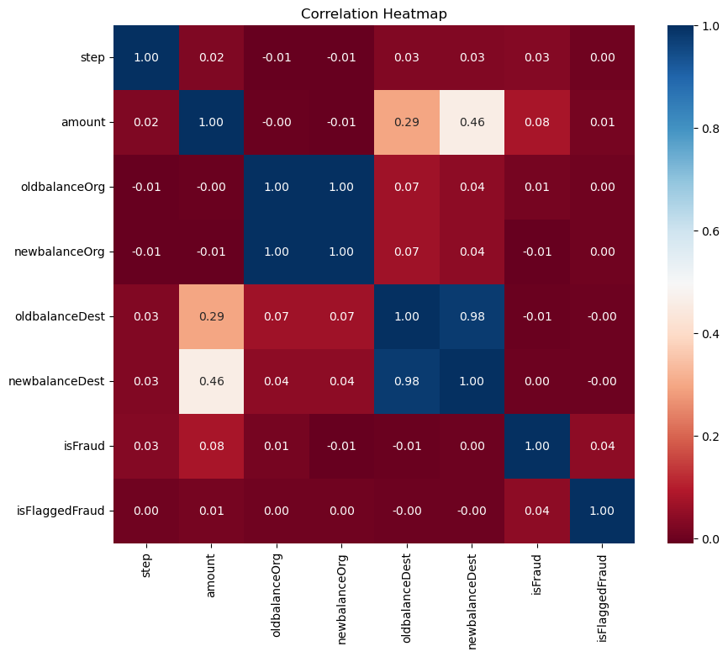
Output:

Slide 21
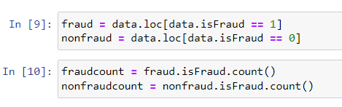
Input Code:

Slide 22
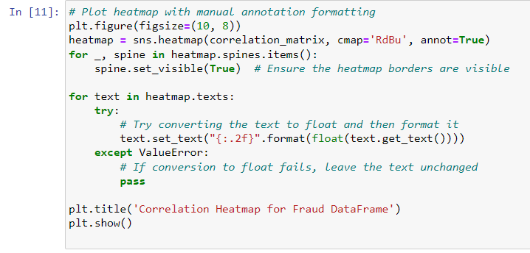
Input Code:

Slide 23

Output:

Slide 24
Analyzing Fraud Flags:
There are 2 flags which stand out to me and it's interesting to look onto: isFraud and isFlaggedFraud column. From the hypothesis, isFraud is the indicator which indicates the actual fraud transactions whereas isFlaggedFraud is what the system prevents the transaction due to some thresholds being triggered. From the above heatmap we can see that there is some relation between other columns and isFlaggedFraud thus there must be relation between isFraud.

Slide 25
Input Code:

Slide 26

Output:

Slide 27
Input Code:

Slide 28
Output:

Slide 29
Addressing the Gap in Fraud Detection:
The plot indicates a clear requirement for a system that can swiftly and dependably identify fraudulent transactions. Currently, the system is allowing fraudulent transactions to go undetected, as they are not being flagged as such. Conducting thorough data exploration could be beneficial to uncover the relationships between various features and potentially identify patterns associated with fraud.

Slide 30
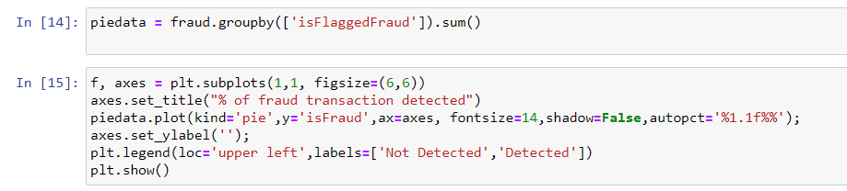
Input Code:

Slide 31
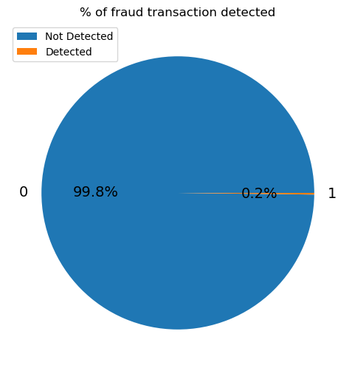
Output:

Slide 32
Data Exploration:
Data exploration is a crucial process in data analysis where analysts examine and summarize data to understand its characteristics. It involves tasks such as calculating descriptive statistics, visualizing data, cleaning data, and identifying relationships between variables. The goal is to gain insights and identify patterns or anomalies in the data, which can guide further analysis and decision-making.

Slide 33
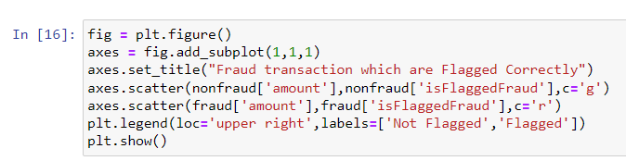
Input Code:

Slide 34
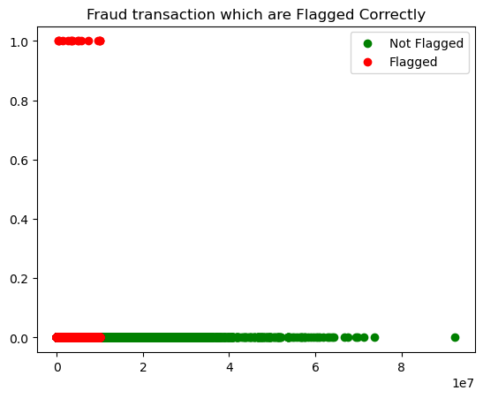
Output:

Slide 35
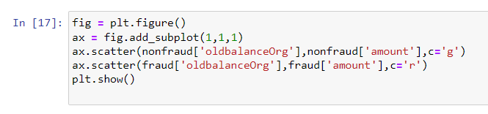
Input Code:

Slide 36
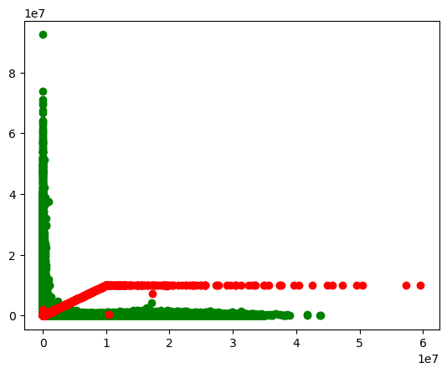
Output:

Slide 37
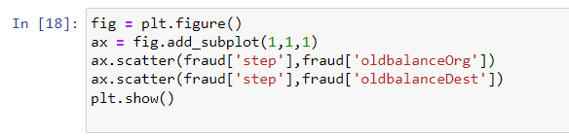
Input Code:

Slide 38
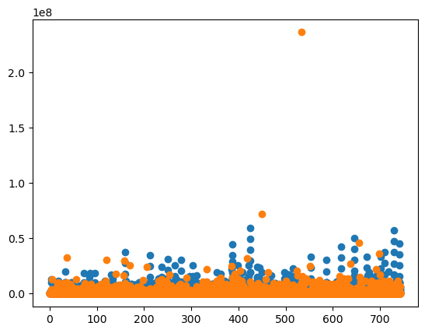
Output:

Slide 39
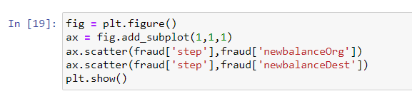
Input Code:

Slide 40
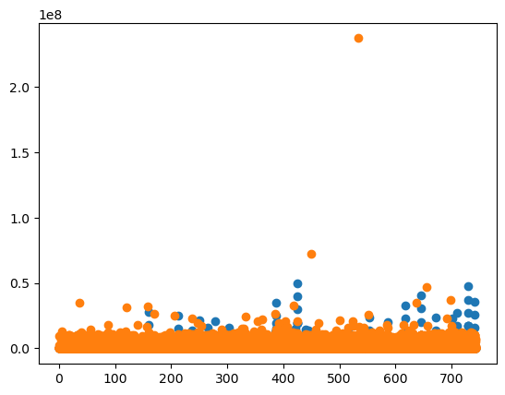
Output:

Slide 41
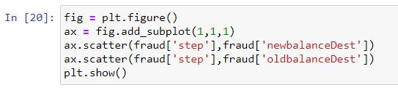
Input Code:

Slide 42
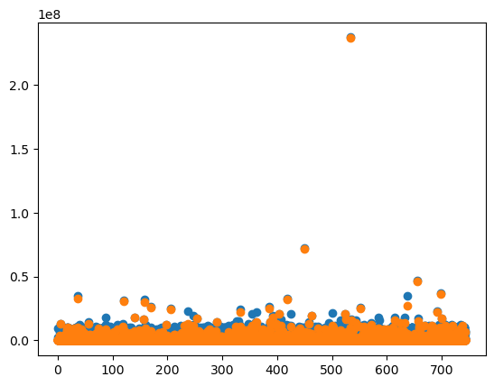
Output:

Slide 43
Data Cleaning:
Data cleaning is a crucial step in data analysis that involves identifying and correcting errors, inconsistencies, and missing values in the dataset. It ensures that the data is accurate, reliable, and ready for analysis. Tasks include handling missing data, removing duplicates, standardizing data formats, handling outliers, correcting errors, and ensuring data consistency. Data cleaning improves the quality of the data, leading to more accurate analysis and reliable insights.

Slide 44
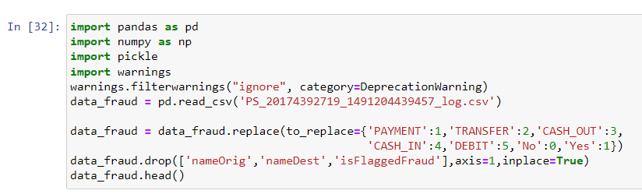
Input Code:

Slide 45
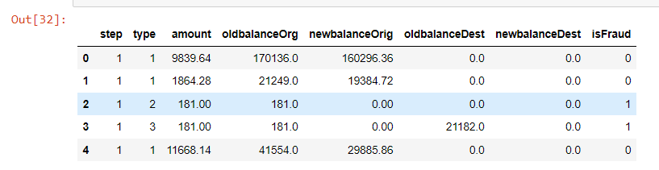
Output:

Slide 46
Random Forest Classifier:
Using a Random Forest Classifier for fraud transaction detection involves preparing the dataset by handling missing values, encoding categorical variables, and balancing the dataset if needed. Relevant features are selected, and the dataset is split into training and testing sets. The Random Forest Classifier is then trained on the training set and tuned for optimal performance. The model is evaluated using metrics like accuracy, precision, recall, and F1-score. Once the model is satisfactory, it can be deployed for real-time or batch processing, with regular monitoring and retraining as necessary. The Random Forest Classifier is chosen for its ability to handle large, high-dimensional, and imbalanced datasets, making it suitable for fraud detection.

Slide 47
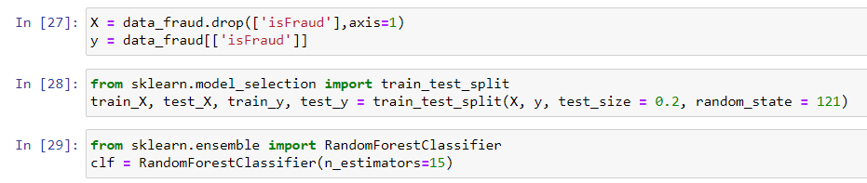
Input Code:

Slide 48
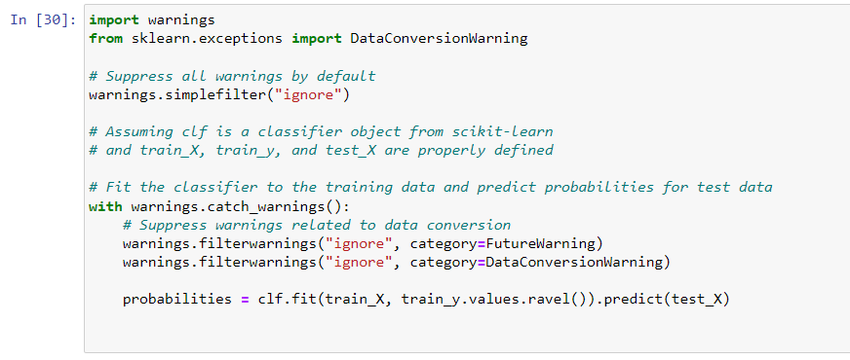
Input Code:

Slide 49
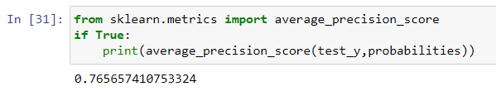
Accuracy of Random Forest Output:

Slide 50
Thank You

